Slide 1

Financial Sentiment Analysis Project:
BY OBBA MARK CALVIN
S23B23\047
B24277

Slide 2
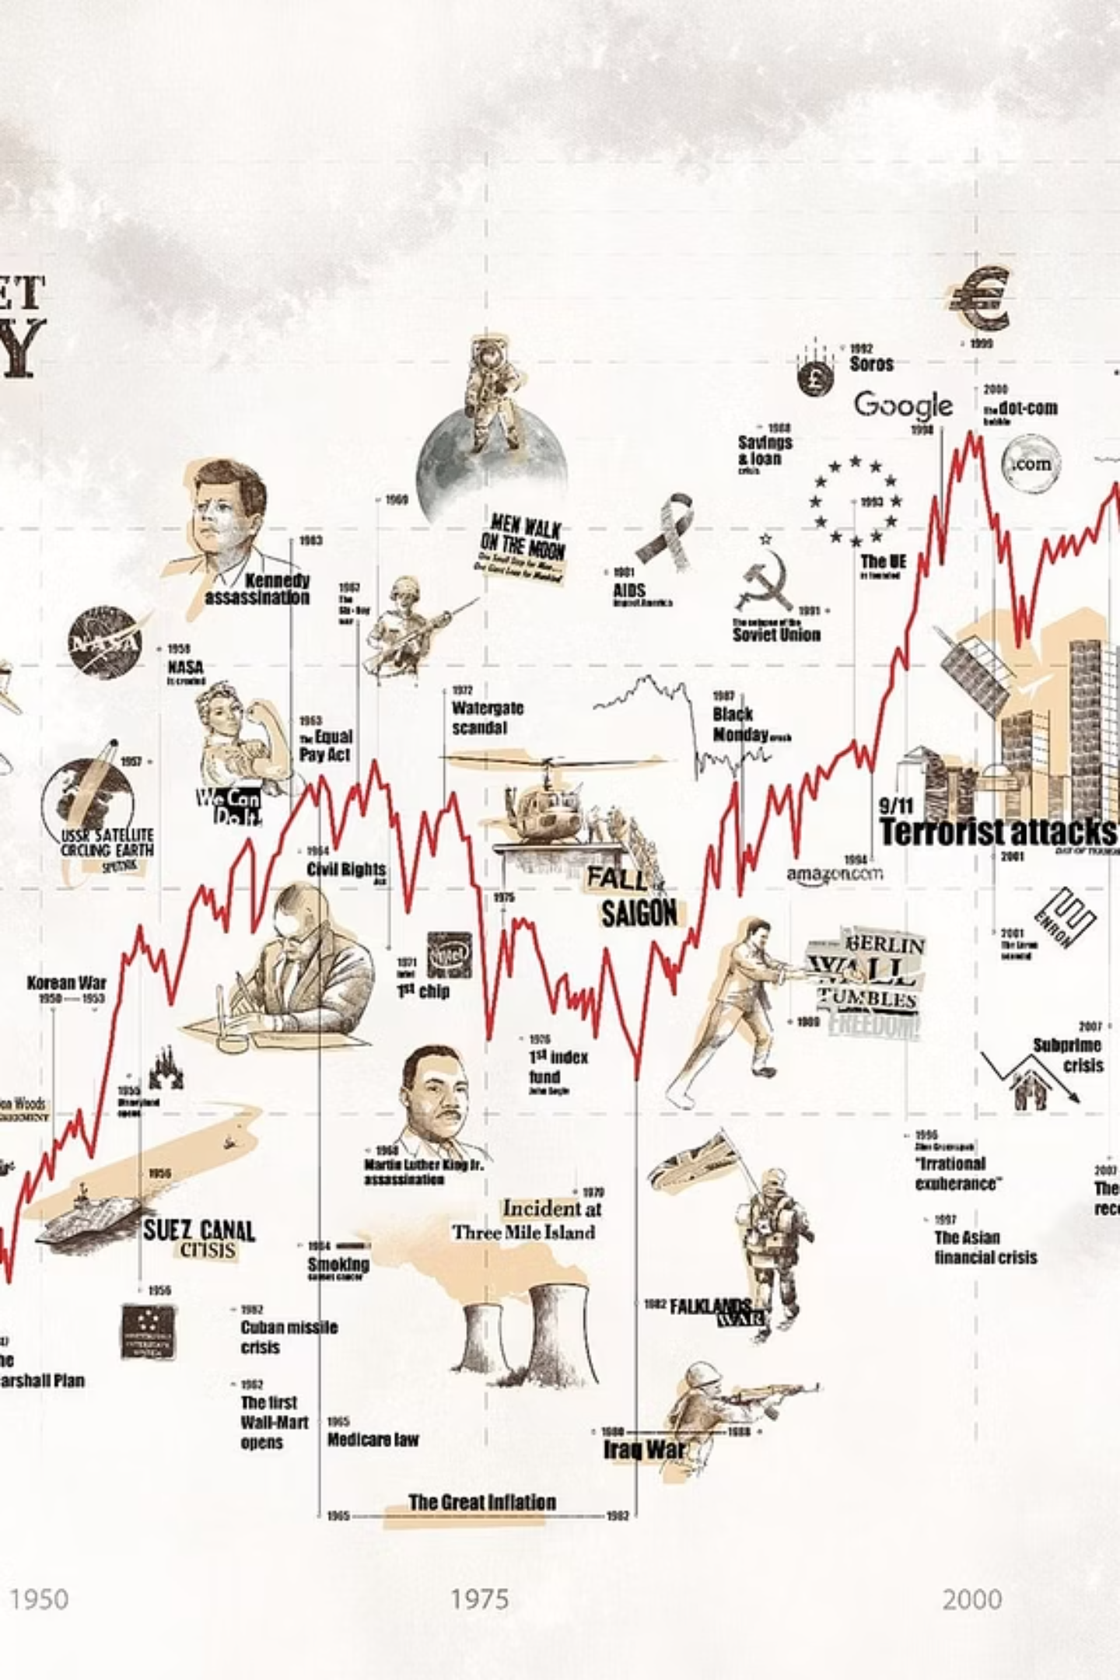
The Evolution of Sentiment Analysis
Sentiment Analysis, or opinion mining, identifies opinions, attitudes, or emotions in text. It originated in the early 2000s with the rise of social media and online reviews, building on foundational work in linguistics and machine learning.
1
Early 2000s: Rule-Based
Lexicon-based methods (e.g., VADER) scored words as positive/negative. Focus on foundational work.
2
2010s: Machine Learning
Shift to supervised models (Naive Bayes, SVM) trained on labeled data for better accuracy.
3
Modern Era: Deep Learning
Advancements like RNNs and Transformers (e.g., BERT) enable context-aware analysis, handling sarcasm and nuance.

Slide 3




Key Applications and Challenges
Sentiment analysis is crucial across various sectors, but faces common hurdles in interpretation.
Key Applications
Core Challenges
Finance: Gauging market sentiment, predicting stock movements, and detecting risks via news and reports.
Sarcasm & Nuance
Difficulty in interpreting non-literal language and subtle emotional shifts.
Customer Feedback: Analysing product reviews (e.g., Amazon) and service feedback.
Social Media: Monitoring brand reputation and public opinion (e.g., on X/Twitter).
Domain-Specific Language
Terms like "bullish" (positive) or "bearish" (negative) require specialized context.
Politics: Tracking election sentiment and public mood.
Ethical Bias
Ensuring fairness and addressing bias present in training data.

Slide 4




Project Summary: Financial Text Analysis
This project developed a sentiment analysis system for financial texts using Python and scikit-learn, processing 5,842 labeled sentences to classify them as positive, negative, or neutral.
Data Handling
Preprocessing
Loaded 5,842 labeled sentences into a Pandas DataFrame; inspected for integrity (no nulls found).
Removed special characters, lowercased, tokenized, removed stopwords, and applied Porter stemming for cleaner input.
Model Training
Evaluation
Vectorized text using TF-IDF (max_features=5000) and trained a Logistic Regression model.
Achieved 71.17% accuracy and 68.21% F1-score, highlighting strong neutral recall but weak negative performance.
The hands-on work enhanced skills in NLP pipelines and demonstrated practical sentiment analysis for financial decision-making.

Slide 5






Exploratory Data Analysis (EDA) Findings
EDA provided crucial insights into the dataset's characteristics, revealing class imbalance and sentiment-linked patterns.
Keyword Identification
Word clouds and frequency counters identified distinct sentiment-linked keywords (e.g., "profit" for positive, "loss" for negative).
Sentiment Distribution
Dataset is imbalanced: Neutral is dominant (approx. 53%), followed by Positive (32%), and Negative (15%).
Sentence Length
Neutral sentences are typically longer and more variable (median 15-20 words), while emotional sentences are shorter (10-15 words).

Slide 6
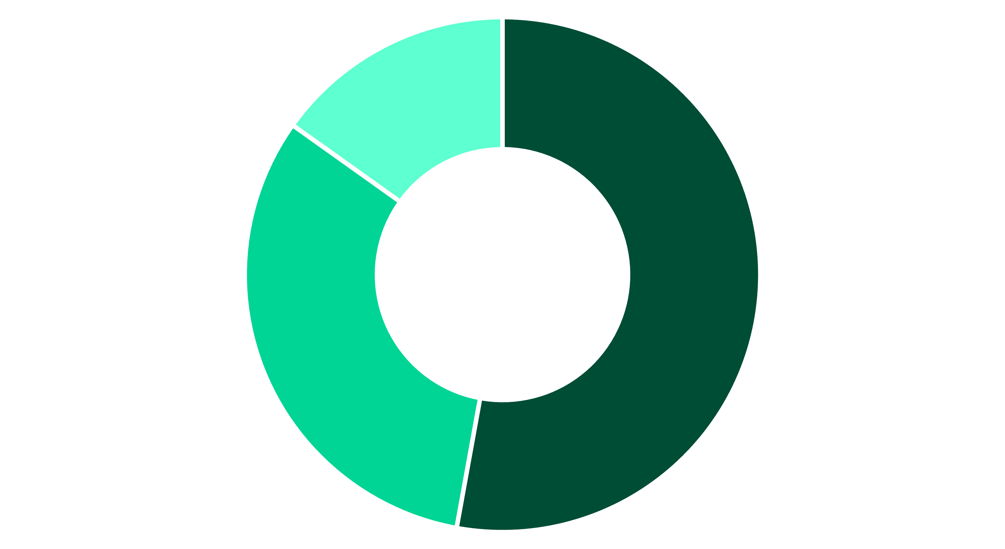
Research Question 1: Sentiment Distribution
What is the overall sentiment distribution in the financial text data?
Neutral
Positive
Negative
The dataset is heavily imbalanced, with neutral sentiments being the most prevalent (approximately 53%). This suggests that financial texts are often objective and factual rather than strongly emotionally
charged.

Slide 7
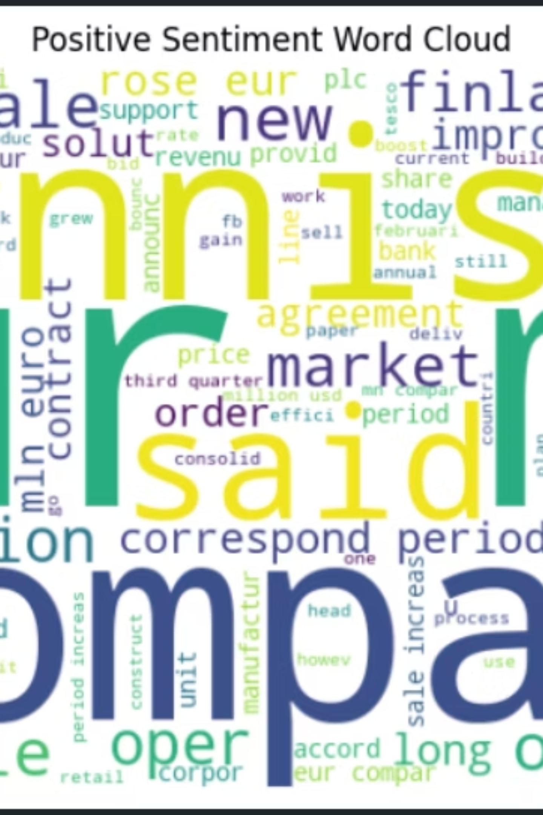



Research Question 2: Sentiment-Specific Keywords
Are there specific keywords or phrases strongly associated with positive, negative, or neutral sentiment?
Positive
Words like "profit," "increase," "growth," "up," and "strong" appear frequently, indicating optimistic financial outcomes.
Negative
Terms such as "loss," "decline," "down," "weak," and "low" dominate, reflecting pessimistic contexts.
Neutral
Generic phrases like "company," "market," "sale," and "report" are common, focusing on factual reporting without emotional bias.

Slide 8
Research Question 3: Model Viability and Performance
Can we build a model that accurately predicts the sentiment of a financial sentence?
71.17%
68.21%
0.89
0.15
Accuracy
F1-Score
Neutral Recall
Negative Recall
The Logistic Regression model achieved moderate overall accuracy using TF-IDF features.
Weighted F1-score, indicating reasonable performance across classes, despite imbalance.
The model performed best on neutral predictions, demonstrating high recall for the majority class.
The model significantly underperformed on negative sentiments due to the low number of samples in this class.
While the model proves feasibility, the class imbalance limits accuracy, particularly for the minority negative class. Enhancements like ensemble methods or deep learning could boost performance to 80%+.

Slide 9
Research Question 4: Length-Sentiment Relationship
How does the length of a sentence relate to its sentiment?
Analysis showed a clear distinction in sentence length based on sentiment:
Neutral Sentences: Tend to be longer and more variable in length (median around 15-20 words). They are often descriptive and factual.
Positive & Negative Sentences: Are typically shorter (median 10-15 words). This is likely because they convey direct, concise opinions or facts.
This suggests that sentence length could be a weak, yet noticeable, feature for sentiment prediction, with longer texts being more descriptive and neutral.

Slide 10




Key Insights and Future Directions
The project successfully built a foundational sentiment analysis system, providing critical insights into financial text data and highlighting areas for future refinement.
Clean Data Pipeline
Imbalance Challenge
Effective preprocessing (stemming, stopword removal) resulted in cleaner, standardized text, improving feature quality.
Neutral sentiment dominance (53%) limits the model's ability to accurately predict minority classes (Negative).
Future Improvement
Practical Value
Need for more sophisticated approaches like SMOTE for handling imbalance or advanced models (e.g., LSTM or BERT) for higher accuracy.
Simple NLP pipelines can reasonably predict financial sentiments, aiding applications like stock market monitoring and investor sentiment tracking.
The project underscores the importance of addressing class imbalance and nuanced financial language for real-world deployment.

